Slide 1
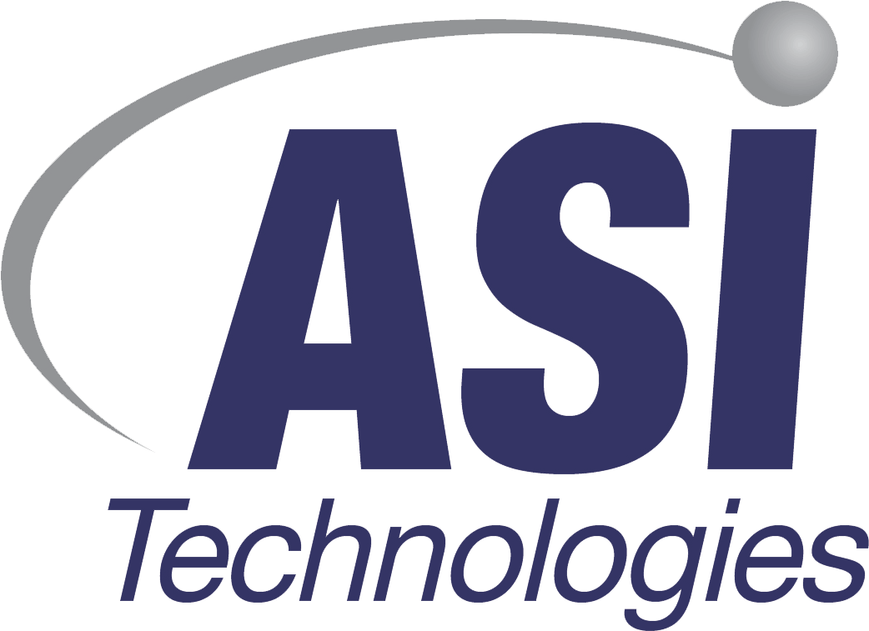
Vayo – world leader in manufacturing process digitalization
Advance solutions for DFM/DFA/DFX
Product design audit and verification reports for the best quality and efficient production
Know-how digitalization of stencil design for the best printing process quality
Automatic stencil requirements preparation and re-use for new stencils design

Slide 2
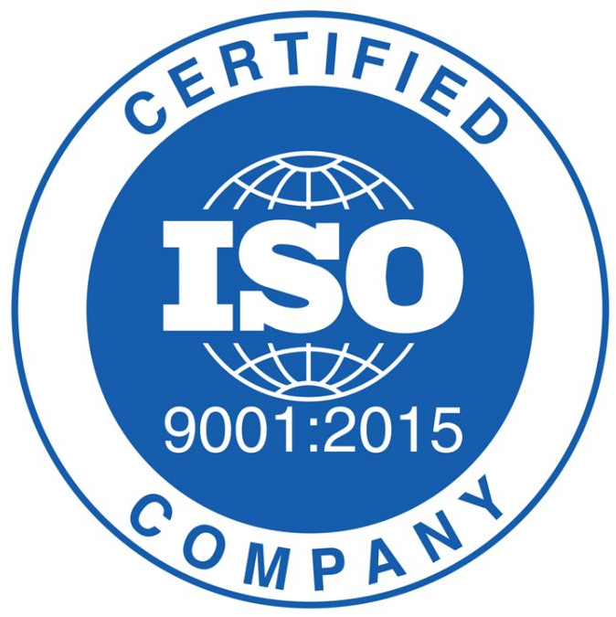
= 19 years of dedication
intelligent software, pleasant work
Aim multiple NPI fields
DFX/DFM/DFA analysis, Placement programming, printing/stencil process, testing & inspection, work instruction, …
20+ NPI software products
Developed fully in-house, Owns >25 products & copyrights solely
19 years
1 focus
100+ employees
Core members with 20+ SMT industry experience, 40%+ are from product development
500+ clients, 20+ countries
500+ clients, >2500 installations from US/Mexico/Brazil/
Germany/France/UK/Hungary/Israel/China/Japan/Malaysia/Thailand/…
10+ strategy partners
Partnerships with leading equipment/system providers (ASM/Fuji/Panasonic/Keysight/ViTrox/Cogiscan…)
intelligent NPI software
automate design to manufacturing

Slide 3
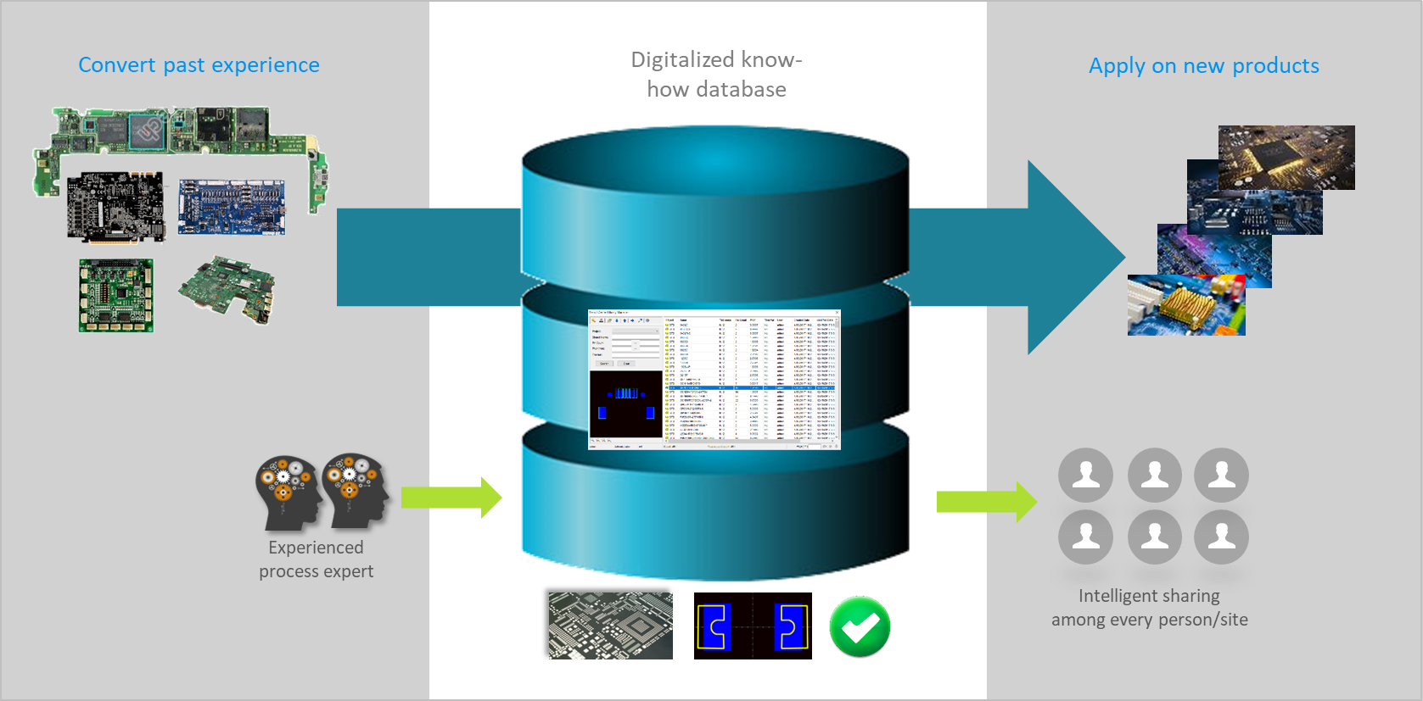
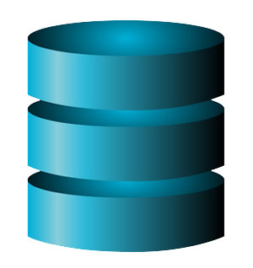
A. core process know-how digitalization
Digitalize core process for manufacturing excellence (quality stabilization, knowledge transfer)
A
core PCBA process know-how digitalization
Experience (know-how) digitalization, automatic reuse best practice, ensure same process result

Slide 4
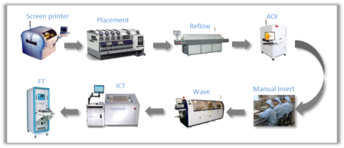
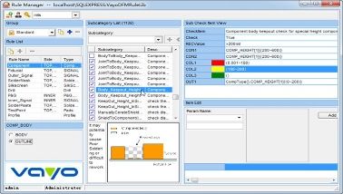
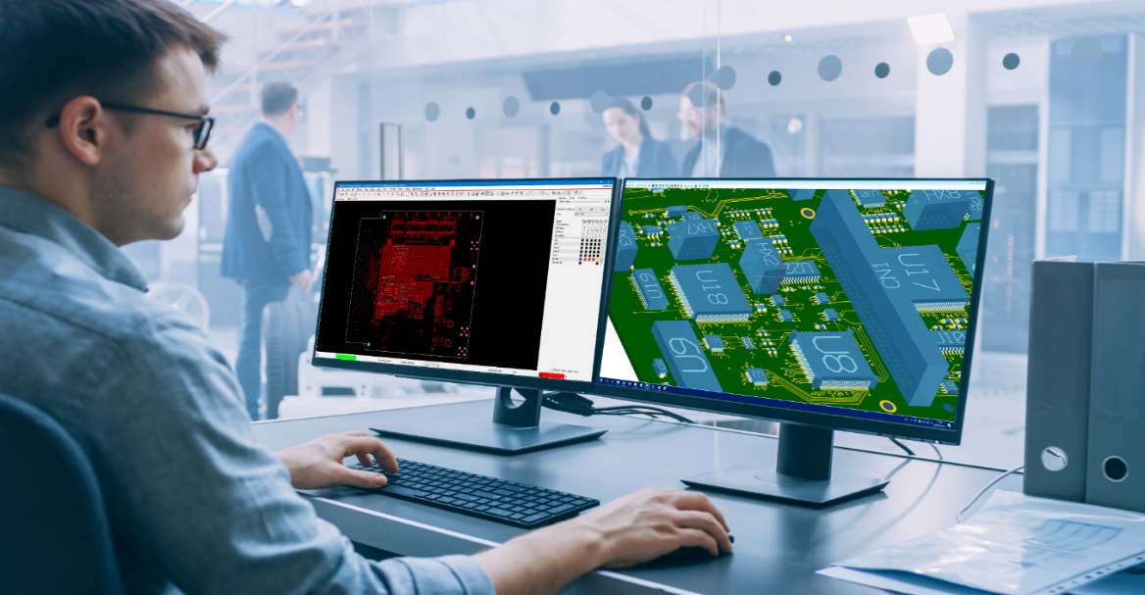
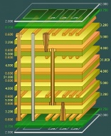
B. DFX/DFM/DFA know-how digitalization
Drive manufacturing success prior to design fix
DFX know-how library
PCB assembly
a. Feedback to design for revision
B
DFX/DFM/DFA
know-how digitalization
b. Alert manufacturing difficulties
PCB design
PCB fabrication
Expand know-how digitalization from core process step to entire process steps of PCB assembly, fabrication & design

