Slide 1
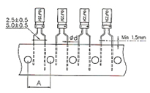
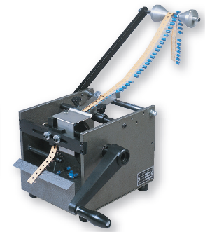
BEST SOLUTIONS TO MEET YOUR NEEDS
Manual Taped Radial Lead Cutting Equipment
Manual Taped Radial Lead Trimmer by Hand Crank
ASI-MTRLT-101
Dimension:430L x320W x 320H mm
Weight: 17kgs
Capability: 25,000 pcs/hr (Manual)
ASI-MTRLT-101 Is for standard paper tape bare hole pitch (A)-12.7 mm
ASI-MTRLT-101-S Is for paper type bare hole pitch (A)-15 mm
ASI-MTRLT-101-S
AIM Solder Israel ltd. Netser Sereni, 70395 ISRAEL
sales@asi-tech.co.il TEL: 972–8-9208844 FAX: 972-8-9207711
ע"מ 5

